Slide 1
Dimension Data Customer Attrition Prediction
By Samuel G.

Slide 2
Dimension Data is faced with a challenge in business applications, customer experience where there is a high Retention Loss rate with most of its customers abandoning their services and switching to their competitors. The company has identified this problem and is now seeking to build a classifier that will help them predict whether a customer will soon stop doing business with them. This will be done by proper analysis using their dataset to gain insights on what factors result in a high Attrition rate. A prediction model will be developed and this will provide insights and recommendations to the information & telecommunication company that will help them retain customers and avoid loss.

Slide 3
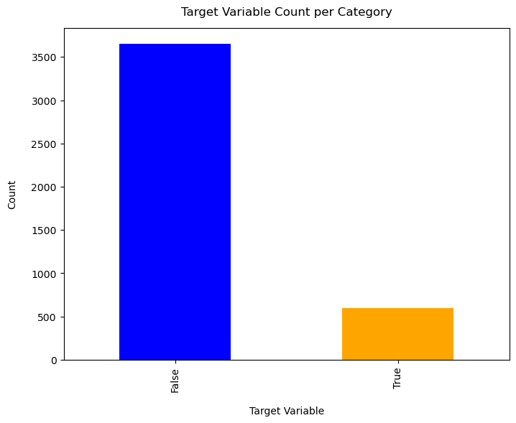

Slide 4
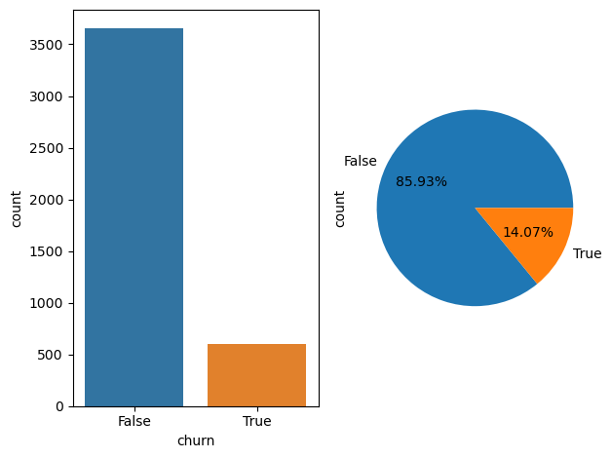

Slide 5
The is a high number of False count than the True count of churn by customers

Slide 6
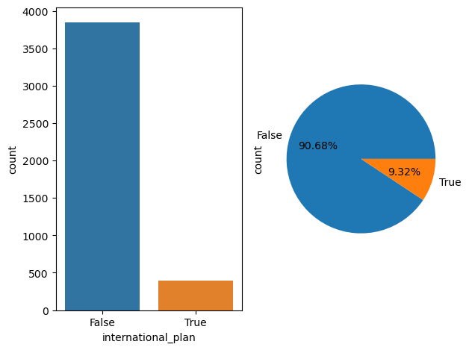

Slide 7
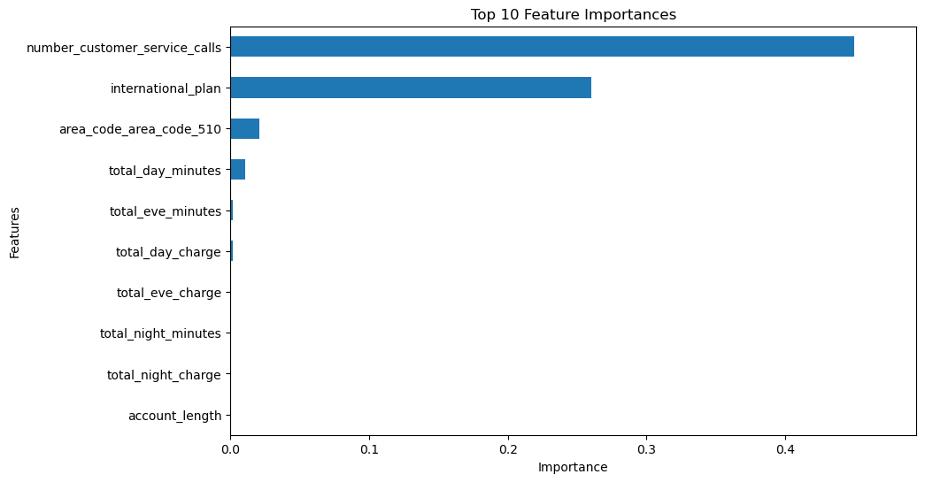

Slide 8
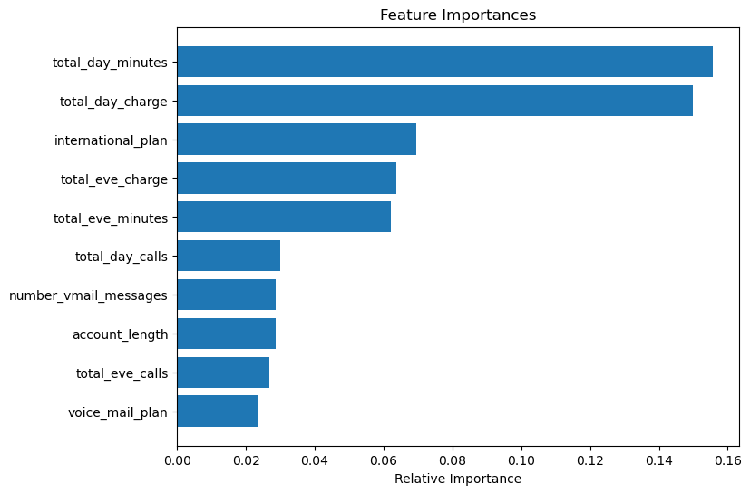

Slide 9
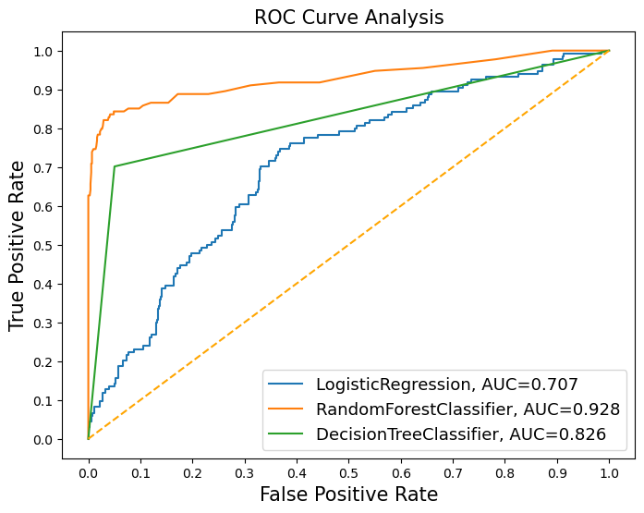

Slide 10
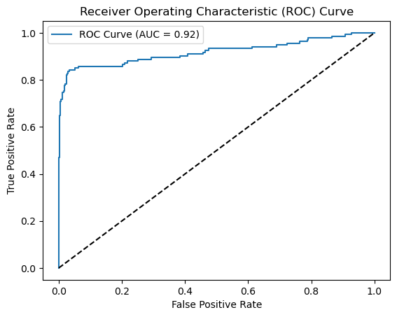

Slide 11
conclusion
The Random Forest classifier has a recall score of 73% for predicting customer churn, effectively identifying many actual churners. While this is a good start, further feature engineering could enhance the model's performance. Improving recall is crucial for reducing misclassifications and better retaining at-risk customers. Continuous refinement through feature engineering is recommended to boost the model's accuracy and effectiveness.

Slide 12
Reccomendation
To address higher churn rates, it is recommended to implement targeted promotional strategies, such as offering exclusive discounts to customers in specific regions. Improving customer service by enhancing training programs for representatives is also proposed to boost satisfaction and reduce churn. Additionally, reviewing the pricing structure for various charges and introducing discounted packages can make offerings more competitive. Lastly, enhancing the voicemail plan's value through new features or discounts aims to increase customer adoption and retention.

Slide 13
Thank you.

